Slide 1
Presentation on POLYGON(Surface) Rendering Method
By Prasamsha Nepal
Bsc csit(2080)

Slide 2
Polygon rendering is the technique of calculating intensity and color considerations for a polygon. There are two ways of polygon rendering:
Rendering each polygon surface with single intensity, which is also called as simple rendering method.
Constant Intensity shading method (Flat Shading)
Calculate intensity at each point of the surface using interpolation scheme.
Gouraud shading method (Intensity Interpolation)
Phong Shading method (Normal Vector Interpolation)

Slide 3
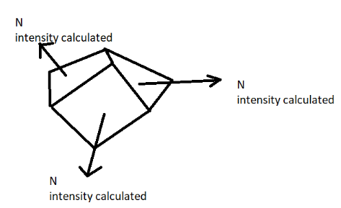
1. Constant Intensity Shading (Flat Shading)
Polygon surface must be one faced of a polyhedron and is not a section of a curved surface.
This approach implies an illumination model once to determine a single intensity value that is then used to render an entire polygon.

Slide 4
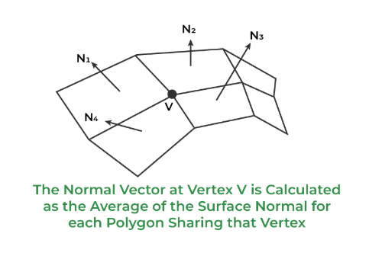
Interpolating Shading 1. Gouraud Shading
Each polygon surface is rendered with Gouraud shading by performing following calculations:
1.Determine the average unit normal vector at each vertex. At each polygon vertex, we obtain a normal vertex by averaging the surface normal of all polygon sharing the vertex as:

Slide 5
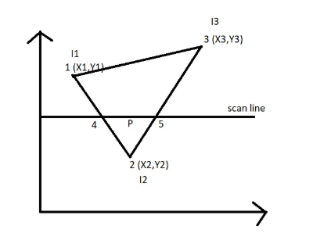
V=[N1+N2+N3+N4]/|N1+N2+N3+N4|
Where, V is the normal vector at vertex sharing four surface.
Once the V is known , intensity at the vertex can be obtained from lighting model.

Slide 6
In the above example, the vertex values and intensities of 1,2,3 are given. By linear interpolating, we can find the intensity at point 4 (by points 1 and 2) and at point 5 (by points 3 and 2)
I4 = (y4-y2/y1-y2)*I1 + (y1-y4/y1-y2)*I2
I5 = (y5-y2/y3-y2)*I3 + (y3-y5/y3-y2)*I2

Slide 7
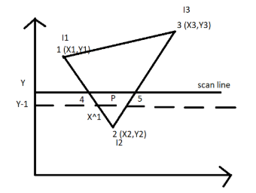
I1 intensity at vertex 1
I2 intensity at vertex 2
I3 intensity at vertex 3
I4 intensity at vertex 4
I5 intensity at vertex 5

Slide 8
Now we can able to find the intensity at point p (by points 4 and 5)
Ip = (X5-Xp/X5-X4)*I4 + (Xp-X4/X5-X4)*I5
And now we are taking y-1 as our next scanline.

Slide 9
Then the incremental calculation are used to obtain successive edge intensity values between scanlines as:
I=(y-y2)/(y1-y2)I1 + (y1-y)/(y1-y2)I2
Then we can obtain the intensity along this edge for next scan line at y-1 poaition as:
I’ = I + ((I2-I1)/y1-y1)
Simliarly, calculations are made to obtain intensity successive horizontal ppixel.

Slide 10
Advantages of Gouraud Shading
Gouraud shading discards the intensity discontinuities associated with the constant shading model.
Linear intensity interpolation can cause bright or dark intensity streaks, called match bands, to appear on the surface.
The match band effect can decrease by dividing the surface into a higher no of polygon faces or by using other methods such as Phong shading which requires more calculations .

Slide 11
Disadvantage of Gouraud shading
Highlights on the surface are sometimes displayed with anomalous shapes.
The linear intensity interpolation can result bright or dark intensity streaks to appear on the surface. These bright or dark intensity streaks, are called Mach bands. The mach band effect can be reduced by breaking the surface into a greater number of smaller polygons.
Sharp drop of intensity values on the polygon surface can not be displayed.

Slide 12
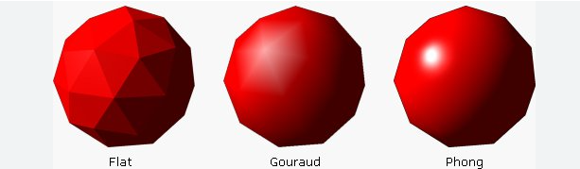

Slide 13
2. Phong Shading
Phong shading is a more accurate interpolation-based approach that can be used for rendering a polygon. It was developed by Phong Bui Tuong.It improves upon the Gourand Shading and provides a better approximation of the shading of any smooth surface. It interpolates the normal vector instead of the intensity values.

Slide 14
Surface rendering is done with the help of Phong shading in the following manner:
Determine the average unit normal vector at each polygon vertex.
So, for n polygons => summation of Ni/ | summation of Ni | (where i is initialized from 1 to N)

Slide 15
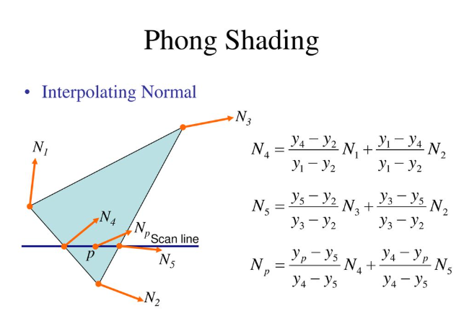
Linearly interpolate the vertex normal over the surfaces of the polygon.
N= (y-y2)/(y1-y2) N1 + (y1-y)/(y1-y2) N2

Slide 16
Algorithm
Determine the average unit normal vector at each polygon vertex.
Linearly interpolate the vertex normal over the surface of the polygon.
Apply an illumination model along each scan line to calculate pixel intensities for the surface points. The intensity value is calculated using the interpolated normal vector.

Slide 17
Advantages
It display more realistic highlights on a surface.
It reduces the match band effect.
It gives more accureate result.

Slide 18
Disadvantages
It requires more calculation.
It is slower as compared to the Gourand Shading.
It greatly increases the cost of shading steeply.

Slide 19
Thankyou

